Slide 1
I400 – Application Development in Java
Lecture 6

Slide 2
Today
CH 7 – Arrays
Sort / Search
CH 8 - Multi-dimensional Arrays

Slide 3
Array Reminder
We covered the introductory material for Arrays last time, so make sure you have the previous slides as well!

Slide 4
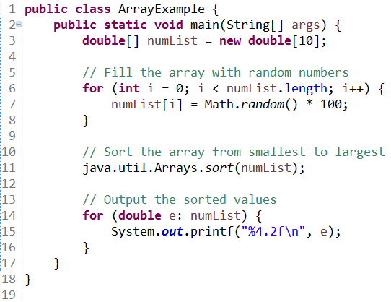

Sorting an Array
The java.util.Arrays class contains an easy way to sort an array:

Slide 5
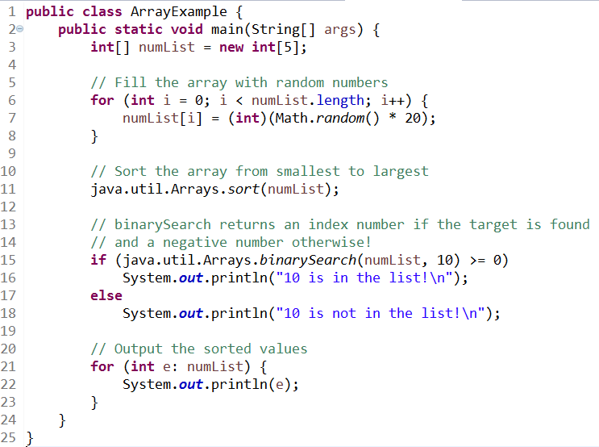
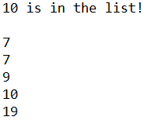
Searching an Array
We can also use its built-in Binary Search, but it requires a sorted array:

Slide 6
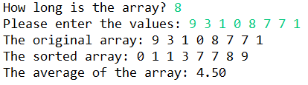
Array Practice (Group Work)
Write a program that replicates this exchange, for any size array:
Make sure you don’t lose the unsorted array!

Slide 7
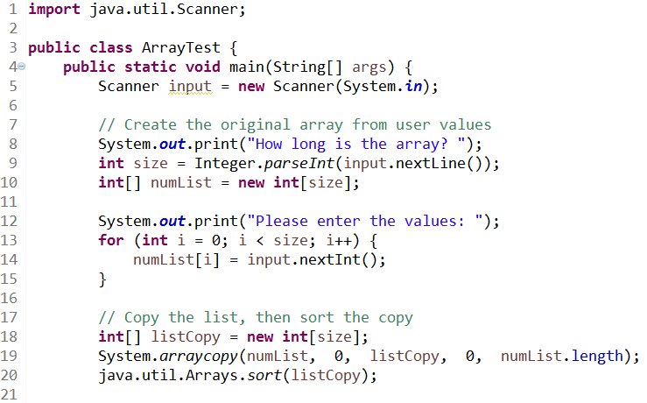
Array Practice (Solution pt 1)

Slide 8
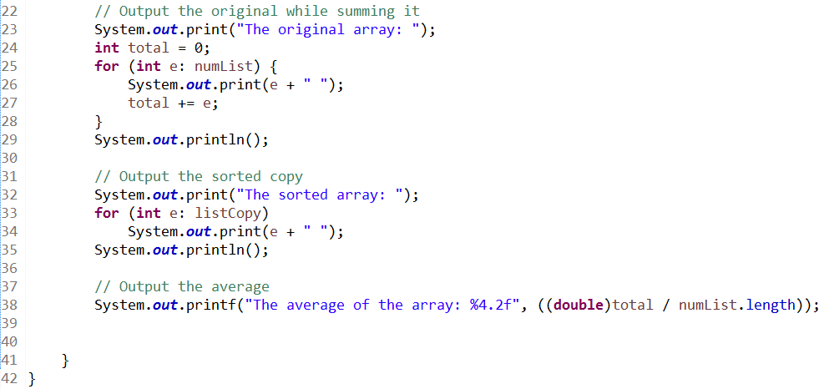
Array Practice (Solution pt 2)

Slide 9
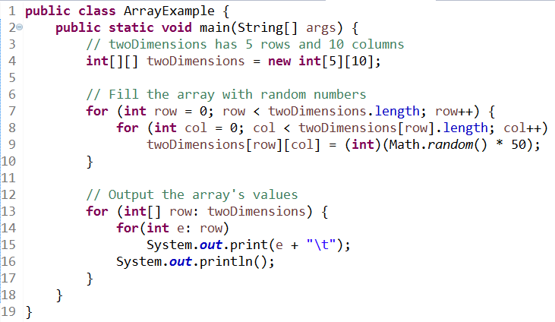
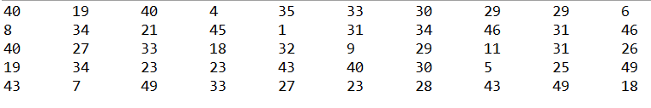
Two-Dimensional Arrays
Arrays can have other arrays as their elements. This arrangement is commonly called a two-dimensional array.

Slide 10
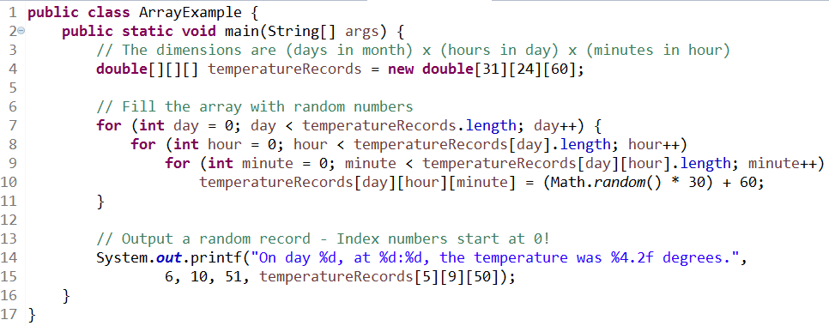
Multi-Dimensional Arrays
Arrays with more than two dimensions also exist!

Slide 11
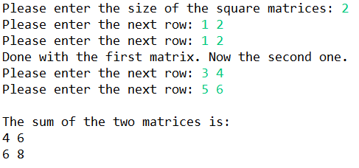
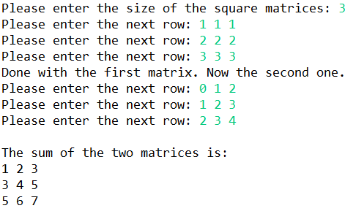
Matrix Addition (Group Work)
Write a program that replicates this type of exchange:
Don’t replicate code – use good functional design. Make sure your program works for any size of square matrix.

Slide 12
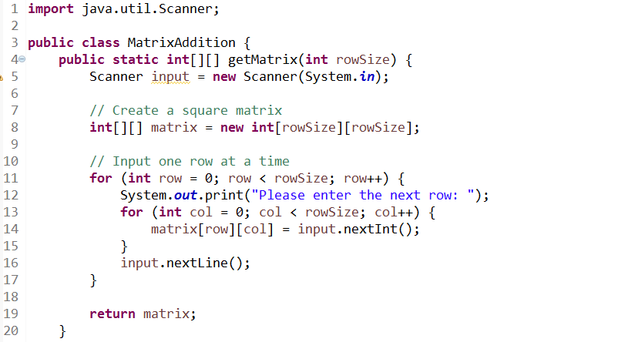
Matrix Addition (Solution pt 1)

Slide 13
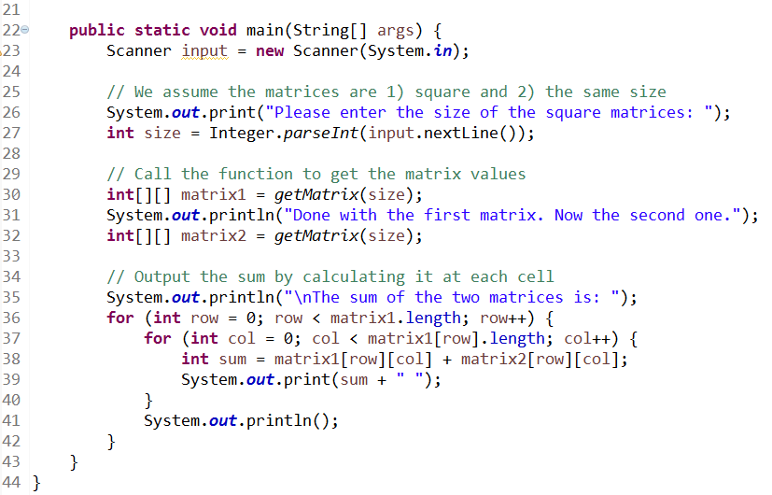
Matrix Addition (Solution pt 2)

Slide 14
Questions?

